Slide 1
Smart Stove Motive : Cooking Made Safe, Smart and Simple
Robotics Event at Army Public School
By
Rushil Rawat
DPS Noida

Slide 2
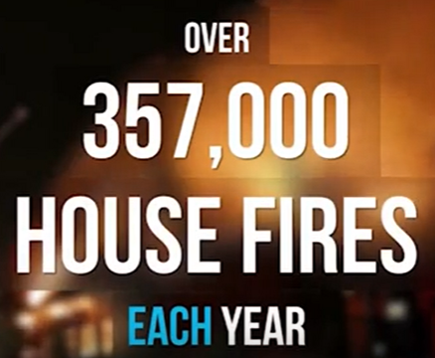
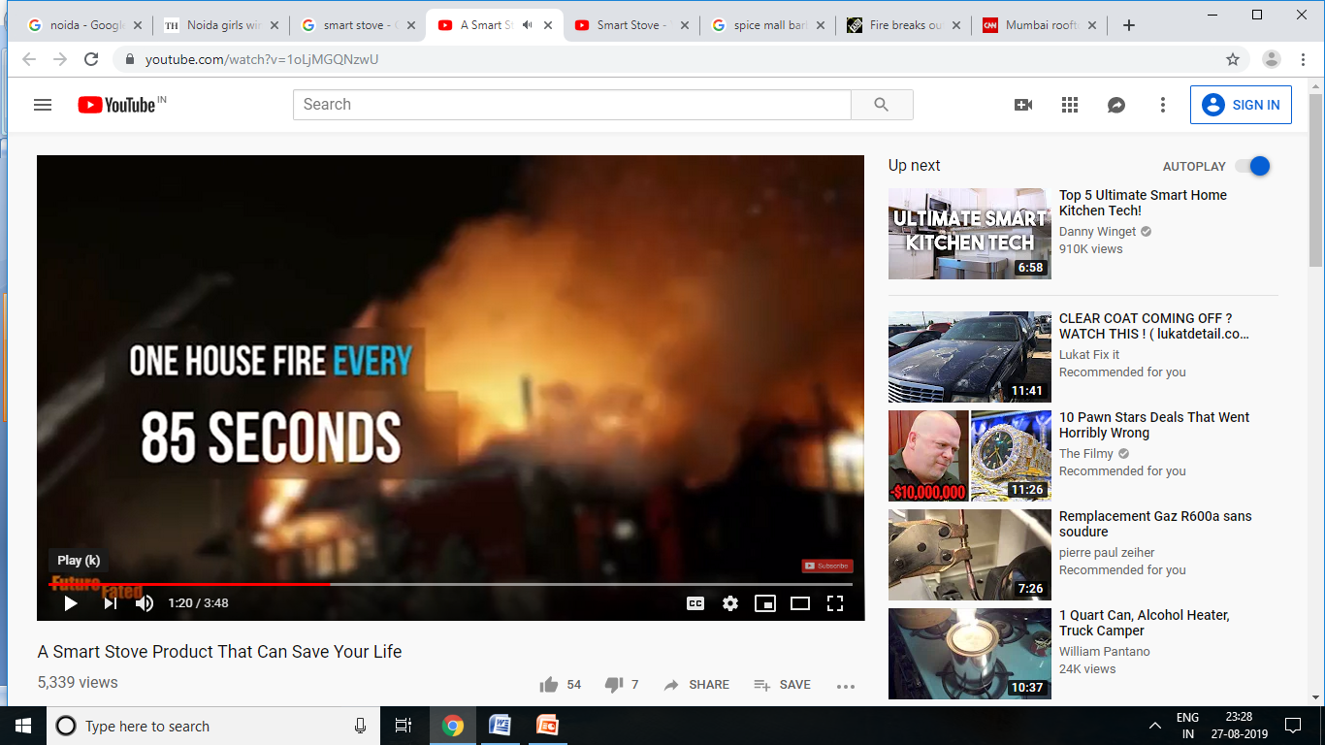

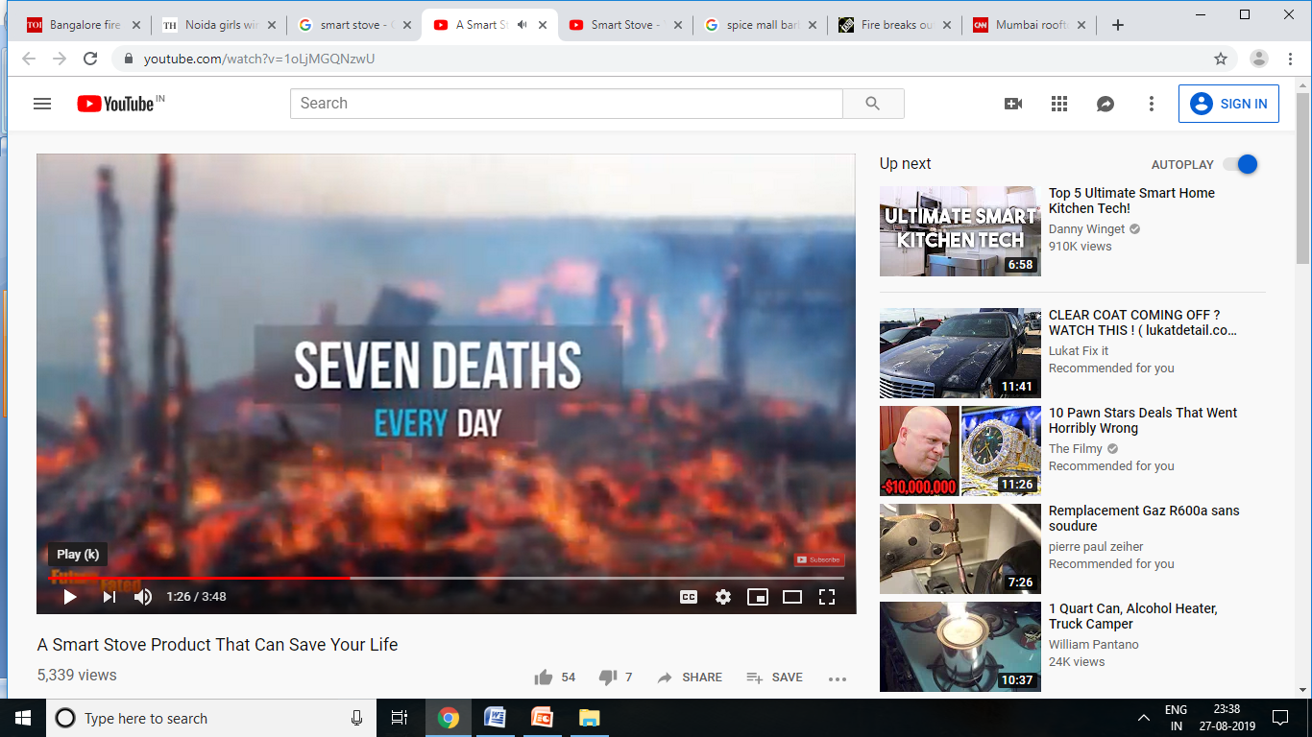
Why Smart Stove
Fire breaks out at Spice World Noida mall on Monday morning - fire started at Barbeque nation restaurant
Fire breaks out-in-kitchen-of-residential-building-in-Mumbai - July 2019
Bengaluru fire: Five die as fire breaks out at restaurant - Jan 18
Iconic eatery at Kolkata's Park Street shuts down after fire .. May 2019
Mumbai rooftop restaurant fire kills 14 - Dec 2017
United States

Slide 3
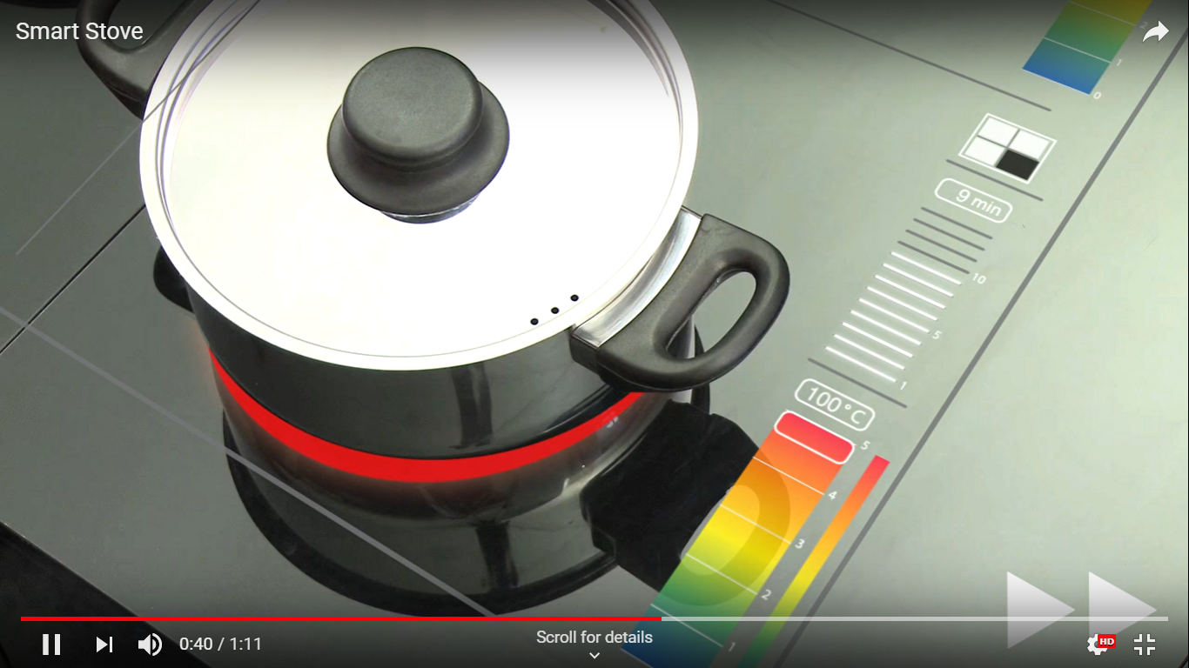

Smart Stove
Automation - Robotics
App based Integration with remote controlled switch on -off
Use Alexa and Google Assistant voice command
Alerts/Sound on their mobile phone on the completion of cooking.
Browse recipes using interactive touch screen
Single integrated device for Chimney, Microwave, Burner and OTG
Concept Model
Future
Timer
Time based Stove - 2 minutes , 5 minutes or 10 min
Ultra Sonic Sensors
Stove will work only when utensils kept
Artificial Intelligence – IOT Robotics
Learns cooking habit and set automatic alerts
Multiple Sensors - measure /smell /watch/smoke/Gas quantity and send alert & act accordingly
Healthy food choices based on calories
Security - Safe and Secure Robotics
Auto cut depending upon situation
Fake Flame
Integrated with Smoke detector , camera
Take control of their security needs from anywhere through smart phones.
Others - Robotics
Support multiple fuels such as Bio gas/PNG/ Solar Panel / Electricity / Gas
Induction cook up surface - heat up only surface touch with utensils
Charge mobile phones, LED lights, radios. - village

Slide 4
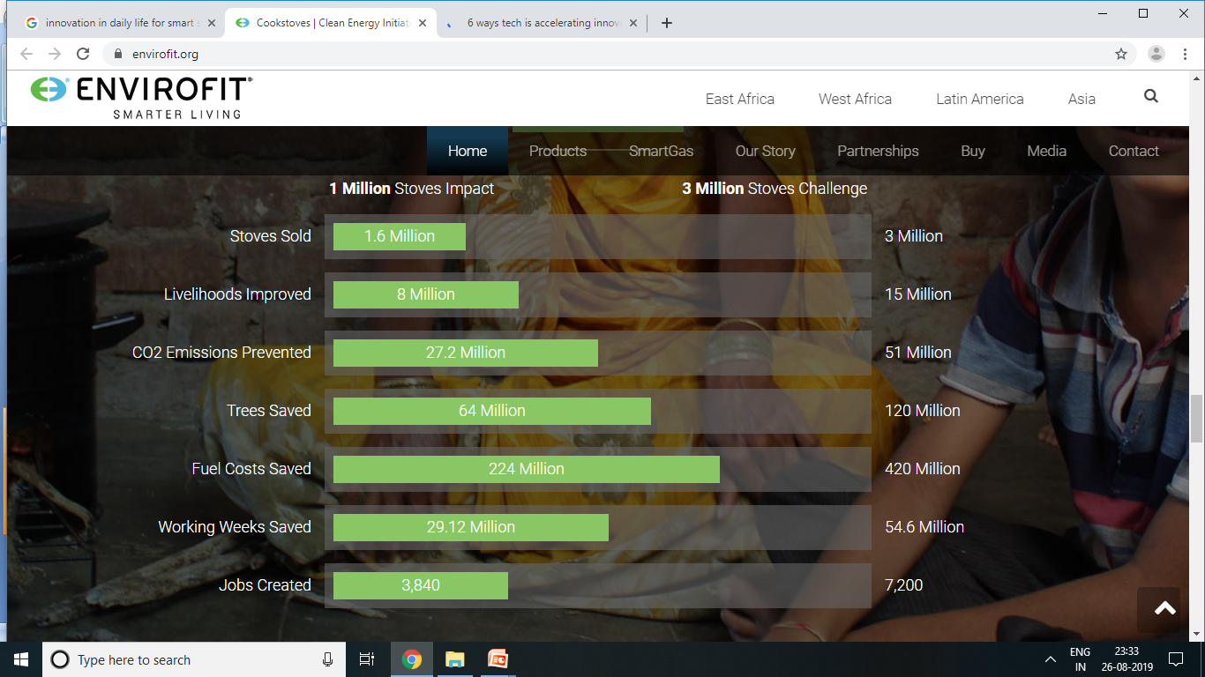
Smart Stove Impact / Measure Performance

